Slide 1

8600-342: Developing Own Leadership Capability Using Action Learning
Business Administration

Slide 2

8600-342: Developing Own Leadership Capability Using Action Learning
Week Seven
Notes:
Management Communication

Slide 3
Assignment Questions
Explain the nature and benefits of action learning (8 marks)
Explain the responsibilities of an individual within an action learning set or group including confidentiality and respect for others (4 marks)
Identify own leadership strengths and limitations based on an assessment of own leadership behaviours and potential (12 marks)
Set personal goals for an extended action learning intervention (8 marks)
Prepare individual action learning plans for involvement in action learning sessions for a minimum of twenty hours (12 marks)

Slide 4
Assignment Questions
Complete planned actions to improve leadership (16 marks)
Monitor and record own participation in action learning sessions (16 marks)
Use feedback from others and own personal reflections to review the effectiveness of action learning undertaken (16 marks)
Identify follow up actions required to continue the leadership journey (8 marks)

Slide 5
Content
The Importance of Feedback
Preparing to Give Performance-Related Feedback
When Giving Performance- Related Feedback
Guidelines for Giving and Receiving Feedback
Why is Receiving Feedback Important for Leaders
A Feedback Model
6 Ways to Give Feedback That Others will Welcome
Feedback in Action learning

Slide 6
Feedback
Feedback is a private, confidential conversation, usually between two people
It is best done face-to-face, rather than at distance -by memo, letter, email or even telephone
The overall purpose is to be helpful not to criticise
The assumption is that all performance improvement or behaviour change starts with a person receiving information about what impact his / her behaviour has had on others

Slide 7
The Importance of Feedback
Is useful because it can help people perform and communicate more effectively
Is necessary when a person needs guidance as regards required behaviours or procedures
Is necessary as part of the process of either correcting performance or praising and recognising good performance
Is necessary for managers too, so that they can find out how their behaviour impacts on others

Slide 8
Preparing to Give Performance-Related Feedback
Have available all the necessary facts, information and data that will be needed - also have it organised for easy reference
Have somewhere to give the feedback in private without disturbances
Allow time and remove / switch off distractions such as telephones
As far as possible notify the person, who will be receiving the feedback, well enough in advance so that they too can prepare

Slide 9
When Giving Performance- Related Feedback
Explain the reason for the feedback session
Explain what concerns or pleases you and why it does son
Stick to the facts
Avoid emotional responses or inflammatory remarks
when giving negative feedback
Focus on the problem - do NOT judge the person getting the feedback when giving negative feedback
Be specific, but neutral and don’t generalise to “soften”the blow when giving negative feedback

Slide 10
Guidelines for Giving and Receiving Feedback
Person giving feedback
Stick to facts – what happened / was observed
Give actual, concrete examples
Avoid judgemental statements
Person receiving feedback
Listen carefully – seek to understand
Ask questions to clarify information
Don’t become emotional / defensive

Slide 11
Why is Receiving Feedback Important for Leaders
Although others may be “subjective” in their experience of our behaviour, it does have an impact on them.
They may take action appropriate (or inappropriate) based on that experience.
The more we open up ourselves to feedback on our behaviour, from those who are willing to give it, the better we are able to understand the impact we have on others.
Based on that insight we can therefore modify our behaviour and develop ourselves so as to become more effective in our workplace interactions.

Slide 12
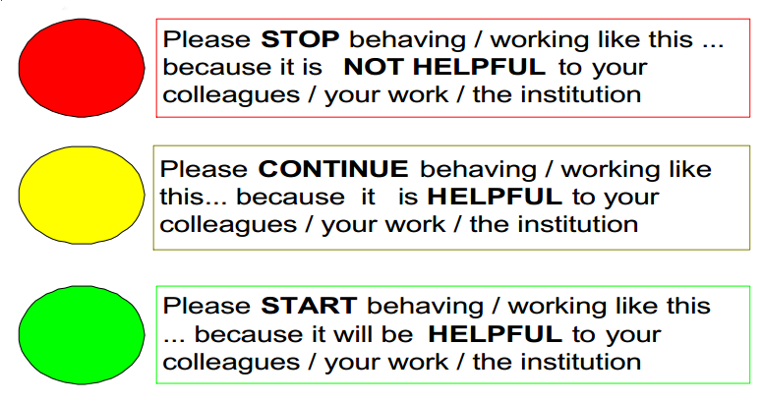
A Feedback Model

Slide 13
6 Ways to Give Feedback That Others will Welcome
• Be accommodating. Ask the person receiving the feedback how he would like to receive it, if it’s possible to give him a choice. Would he prefer email or a private face-to-face conversation? Just trying to show you’re thinking of the other person sets a better tone from the get-go.
• Have your facts straight. It’s easy to read someone the riot act if you were told she was rude to an important customer. But don’t jump to conclusions before you give the worker a chance to tell her side of the story and talk to other people present during the incident, if possible. Nothing will lose you respect faster than levelling false accusations — or make you feel like a bigger fool.

Slide 14
6 Ways to Give Feedback That Others will Welcome
Determine your goals. Don’t kid yourself into believing the reason you told a co-worker his presentation was “flat” was because you were being honest, when in reality you’re still miffed he got a promotion you wanted. Saying you’re just being “authentic” or “transparent” with criticism is a crock when your true motive is to hurt the other person or to try to call attention to yourself with your brash words.
• Be specific. Feedback often can spiral out of control when you start having kitchen sink discussions. That means you drag up incidents that were resolved long ago. Stick to the specifics about current subjects and don’t talk about how you “feel” the person isn’t doing the job correctly or other vague and general comments. Stick to the behaviour that’s the problem.

Slide 15
6 Ways to Give Feedback That Others will Welcome
Agree on a goal. Before you part, reach a decision with the person about what can be done to correct a problem or improve a situation. Let the person offer ideas, and take those into account when determining a goal.
When offering criticism, don’t rehash your complaints over and over. Stick to your agenda, listen carefully to the other person and offer encouragement that you believe things will get better. That way both of you can emerge from the conversation with a better understanding and relationship.

Slide 16
Feedback in Action learning
The secrets to getting anonymous (and thus more likely to be honest) feedback are these:
Assemble a group of people that will provide the feedback. Don’t ask individuals to provide feedback.
I generally invite more people than will really participate; I don’t know who actually does participate.
Naturally, I’m not in the room when this group goes through the Feedback Framework and constructs the feedback for me.
The team appoints a representative who will discuss the group’s feedback with me.

Slide 17
Feedback in Action learning
Here are the steps that allow the assembly of feedback from individuals, but ensure anonymity for all participants:
Kickoff. I schedule a brief session with the managers in my organization to introduce the topic of ‘group generated feedback’ for me. During this session, our time is spent mostly on the topics covered in this article.
Feedback Construction. One of my managers or I will invite a group of people to a ‘feedback construction’ meeting. The group invited for this session usually includes all of the individuals who current report directly to me (regardless of how short or long they have reported to me). Sometimes other individuals who have either reported to me for some portion of the year or have had meaningful interaction with me over the previous year are invited. Generally, I don’t know who actually attends.

Slide 18
Feedback in Action learning
The ‘feedback construction’ meeting itself is self-organizing (much like a group of jurors will self-organize).
The purpose of the meeting is for them to discuss and generate my feedback as a group. This is feedback to me from the group.
The period of performance to be considered for this feedback is generally the previous 12 months.
Participants can elect to use my Feedback Framework, or they can have an alternative framework.
No spying permitted – no one from the group will approach me to tell me what individuals were saying or what was discussed.

Slide 19
Feedback in Action learning
Feedback Discussion. The feedback discussion is led by one person from the group; the group determines who this will be.
  I prefer that this be a one-to-one meeting (I’ve found that when the entire group participates, there is a tendency for individuals to leap into the conversation and amplify certain aspects of the feedback messages – this, unfortunately, can pinpoint the source of feedback to a specific individual, which violates the principle of anonymity
  The feedback presenter can elect to provide feedback in written form or as verbal only.
  There are no alternate or duplicated paths for feedback to me – the only path to me for this feedback is via the one-to-one meeting for sharing the group’s feedback to me.
  When I am receiving the feedback, I will not challenge the message itself or the validity of the message. In all likelihood, I will ask clarifying questions to help me understand the feedback.

Slide 20
Feedback in Action Learning
Getting the most out of action learning is a skilful activity. A really skilful action learner has some skills in each of the following areas: and its we were learn it in the previous section
Questioning
Active listening
Active reflection
Strategic thinking
Giving and receiving feedback
Creative problem solving

Slide 21
Feedback in Action Learning
The 2 key skills are the bolded ones: questioning and active listening. Action learning set meeting are more fruitful events if the members of an action learning set have some skill in each of these areas. How do the feedback skills help in both giving and receiving ways? Let us take each in turn:
Giving and receiving feedback
Feedback is an important element in learning. An action learning set can be a valuable source of feedback. e.g. when a person uses their action learning set to help them reflect on what has happened to them or to test out ideas

Slide 22
Class Activity
A Feedback Framework for Leaders
– The Topics to Explore

Slide 23
Reference
http://www.quickanddirtytips.com/business-career/public-speaking/the-importance-of-feedback
http://www.cf.ac.uk/humrs/staffinfo/organisationaldevelopment/leadership/dashboard/Giving%20and%20Receiving%20Feedback.pdf
http://www.pinnacleprojects.com/index.php/personal-performance/127-want-to-improve-your-performance-then-ask-others-for-feedback
http://quickbase.intuit.com/blog/2012/05/18/6-ways-to-give-feedback-that-others-will-welcome/
http://quickbase.intuit.com/blog/2012/05/18/6-ways-to-give-feedback-that-others-will-welcome/
http://www.jimsimpsonconsultancy.co.uk/wp-content/uploads/2011/04/Action-Learning-skills+GivingReceiving-Feedback.pdf

